Slide 1


HOSPITAL
MANAGEMENT
SYSTEM

Slide 2

OVERVIEW
Problem statement
Introduction
Core Concepts
Source Code
Code analysis
Key Findings
Example
Results
Conclusion

Slide 3


PROBLEM STATEMENT
Hospitals require an efficient way to manage essential operations like patient records, doctor information, appointments, treatments, and billing. Manual handling of these tasks can lead to errors, inefficiencies, and delays.
The Hospital Management System (HMS) project aims to develop a C++ application that automates and simplifies these tasks. This system will:
Store and retrieve patient and doctor information
Schedule and manage patient-doctor appointments
Record treatments and associated costs
Generate accurate billing summaries
The HMS will use object-oriented programming concepts, providing a structured, user-friendly solution that reduces manual workload, minimizes errors, and improves hospital management efficiency.

Slide 4


INTRODUCTION
Hospital Management System in C++This project is a C++ application designed to manage key hospital operations efficiently. It allows for adding patients and doctors, scheduling appointments, recording treatments, and generating billing summaries. Utilizing object-oriented programming concepts, it provides a structured and user-friendly system to streamline hospital management tasks.

Slide 5


CORE CONCEPTS
Classes and Objects
Models’ entities like Patient, Doctor, Appointment, Treatment, and Billing.
Inheritance
Patient and Doctor inherit from Person, reusing attributes like name and id.
Polymorphism and Virtual Functions
display() in Person is a pure virtual function, enabling entity-specific overrides in derived classes.
Encapsulation
Data members are private/protected, accessed via public methods for data security.

Slide 6
CORE CONCEPTS
Constructors
Initializes objects with specific values for members in each class.
Exception Handling
HMSException handles custom errors, enhancing reliability.
Standard Template Library (STL)
vector is used to store lists of patients, doctors, and appointments.

Slide 7

SOURCE CODE & ANALYSIS
SLIDE - 1
HEADER FILES
This header file includes all standard libraries in C++. It's generally discouraged for production code as it can increase compilation time and include unnecessary libraries. In educational or quick coding scenarios, it can be convenient.
Relevant Theory

Slide 8
SOURCE CODE & ANALYSIS
SLIDE - 1
HEADER FILES
This header file includes all standard libraries in C++. It's generally discouraged for production code as it can increase compilation time and include unnecessary libraries. In educational or quick coding scenarios, it can be convenient.
Relevant Theory

Slide 9
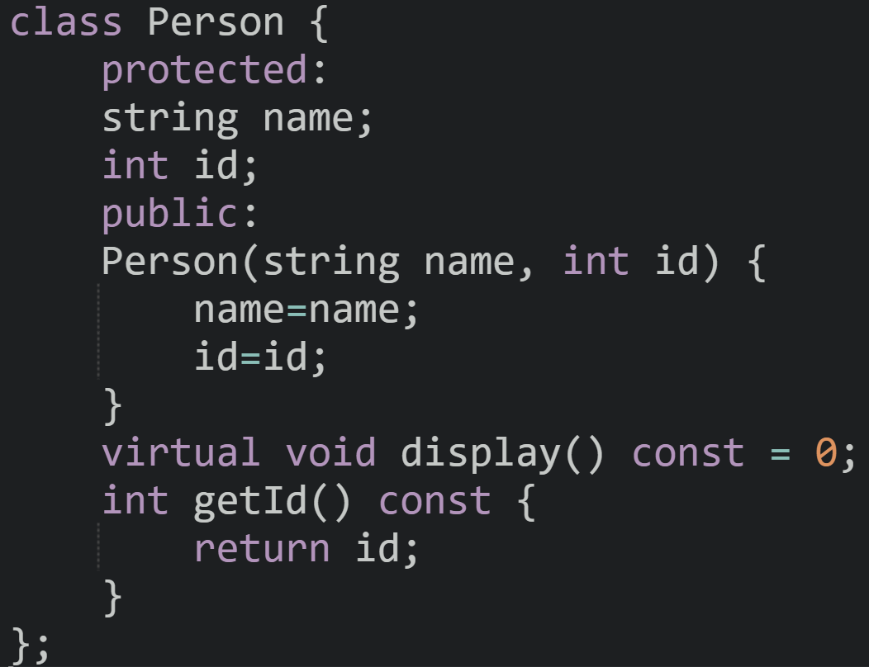
SLIDE - 2
Person Class
Purpose: Serve as a base class for common properties and methods shared by patients and doctors.
Details: - Defines name and id as protected members, accessible by derived classes.
Constructor initializes name and id.
display() is a pure virtual function, ensuring that subclasses must implement their own version, allowing customized output.
getId() returns the ID, aiding in searches.
Functionality: - Centralizes common attributes for people in the system, providing a foundation for inheritance. - Enforces implementation of a custom display() in subclasses, ensuring specific output for each type.
Relevant Theory

Slide 10
SLIDE - 2
Purpose: Serve as a base class for common properties and methods shared by patients and doctors.
Details: - Defines name and id as protected members, accessible by derived classes.
Constructor initializes name and id.
display() is a pure virtual function, ensuring that subclasses must implement their own version, allowing customized output.
getId() returns the ID, aiding in searches.
Functionality: - Centralizes common attributes for people in the system, providing a foundation for inheritance. - Enforces implementation of a custom display() in subclasses, ensuring specific output for each type.
Person Class

Slide 11
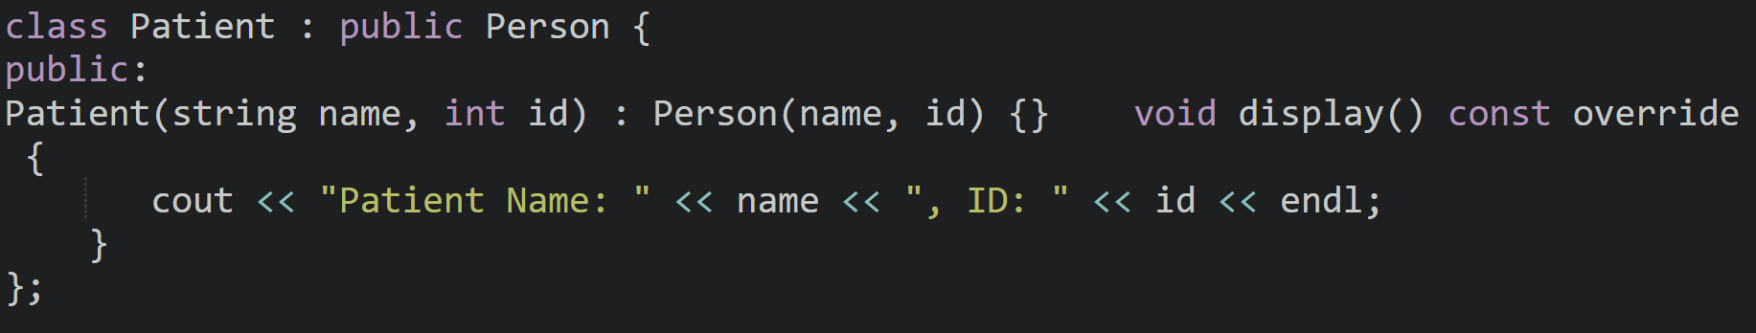
SLIDE - 3
Patient Class
Purpose: Represent a patient with specific details
Details: - Inherits Person, gaining access to name and id.
Implements display() to show patient - specific information, distinguishing patients from doctors.
Functionality: - Allows storage and retrieval of patient-specific data. - Provides clear output for identifying patients within the system.

Slide 12
SLIDE - 3
Patient Class
Purpose: Represent a patient with specific details
Details: - Inherits Person, gaining access to name and id.
Implements display() to show patient - specific information, distinguishing patients from doctors.
Functionality: - Allows storage and retrieval of patient-specific data. - Provides clear output for identifying patients within the system.

Slide 13
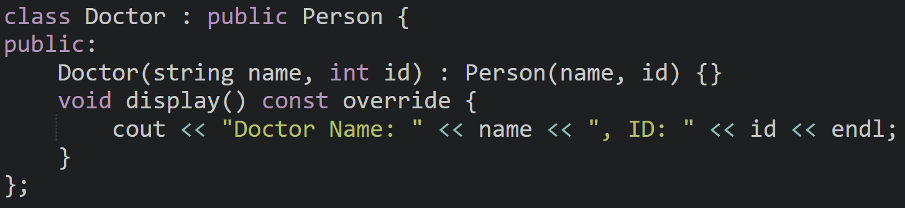
SLIDE - 4
Doctor Class
Relevant Theory
Doctor class inherits from the Person class, demonstrating the concept of
inheritance
C++.
2. The Doctor constructor uses an initializer list to call the Person constructor for initialization.
3. The display function is overridden using const and override to provide class-specific functionality.
4. Polymorphism is utilized to customize the behavior of the display function for the Doctor class.
5. This code showcases object-oriented programming principles like inheritance, encapsulation, and polymorphism.

Slide 14
SLIDE - 4
Doctor Class
Doctor class inherits from the Person class, demonstrating the concept of
inheritance
C++.
2. The Doctor constructor uses an initializer list to call the Person constructor for initialization.
3. The display function is overridden using const and override to provide class-specific functionality.
4. Polymorphism is utilized to customize the behavior of the display function for the Doctor class.
5. This code showcases object-oriented programming principles like inheritance, encapsulation, and polymorphism.

Slide 15
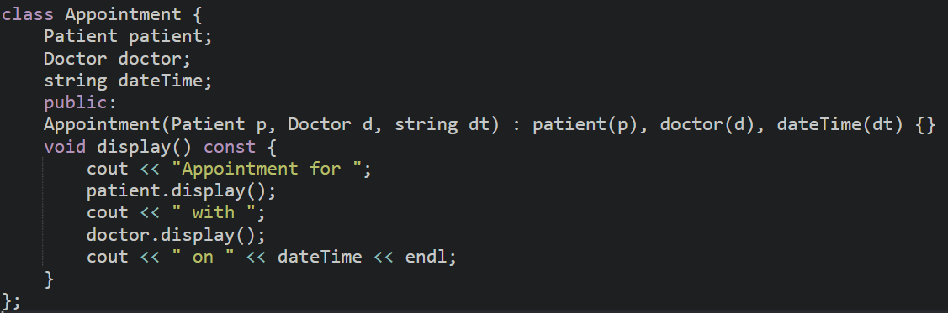
SLIDE - 5
Appointment Class

Slide 16
SLIDE - 5
Appointment Class
The Appointment class represents an association between a Patient and a
Doctor, along with a scheduled date and time.
2. It uses composition, as Patient and Doctor objects are included as member variables.
3. The constructor initializes the member variables using an initializer list.
4. The display function outputs the details of the appointment, leveraging the display functions of the Patient and Doctor classes.
5. This code highlights the principles of composition and reusability in object-oriented programming.

Slide 17
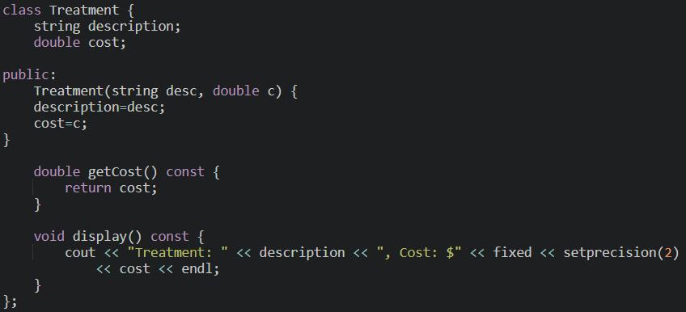
SLIDE - 6
Treatment Class

Slide 18
SLIDE - 6
Treatment Class
Purpose: Represent a treatment, including description and cost details.
Details: Stores description of the treatment and cost.
getCost() returns the treatment cost, aiding in billing calculations.
display() shows the treatment details with a formatted cost.
Functionality: - Manages individual treatment details that can be associated with patients.

Slide 19
SLIDE - 6
Treatment Class
Purpose: Represent a treatment, including description and cost details.
Details: Stores description of the treatment and cost.
getCost() returns the treatment cost, aiding in billing calculations.
display() shows the treatment details with a formatted cost.
Functionality: - Manages individual treatment details that can be associated with patients.

Slide 20
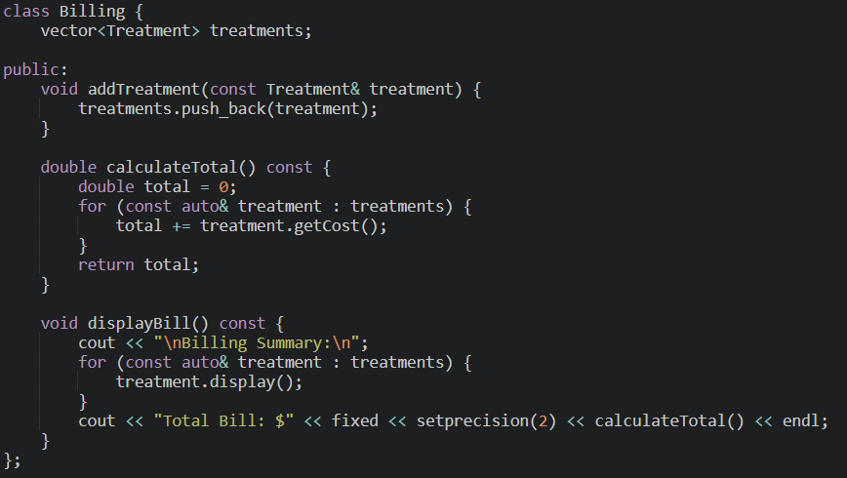
SLIDE - 7
Billing Class

Slide 21
SLIDE - 7
Billing Class
Purpose: Calculate and display the total cost of treatments for billing.
Details: - Maintains a list of treatments in a vector<Treatment>.
addTreatment() allows adding treatments to the list.
calculateTotal() iterates over treatments to sum up costs.
displayBill() shows each treatment and the total amount due.
Functionality: - Simplifies management of billing information by calculating and displaying treatment
costs. - Supports adding multiple treatments and producing a detailed billing summary.

Slide 22

SLIDE - 8
HMSException Class

Slide 23
SLIDE - 8
HMSException Class
Purpose: Define custom exceptions to handle specific errors within the HMS.
Details: - Inherits from runtime_error, providing customized error messages.
Functionality:
- Improves error handling by allowing specific messages for HMS related issues.
- Enables the creation of user-friendly error messages that can guide users on how to resolve issues.

Slide 24
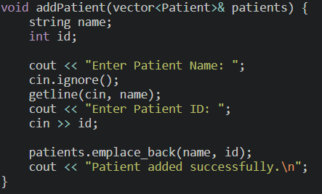
SLIDE - 9
addPatient Function

Slide 25
SLIDE - 9
addPatient Function
Purpose: Capture and add a new patient's information to the system.
Details: Prompts the user for patient name and ID, then stores the patient in a vector<Patient>.
Uses cin.ignore() to handle newline characters before getline().
Functionality: Provides a simple way to add new patients, helping populate the HMS database.
Ensures each patient is uniquely identified by name and ID.

Slide 26
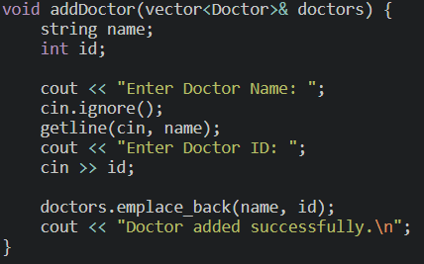
SLIDE - 10
addDoctor Function

Slide 27
SLIDE - 10
addDoctor Function
Purpose: Capture and add a new doctor's information to the system.
Details: Prompts the user for doctor name and ID, then stores the doctor in a vector<Doctor>.
Functionality: Provides a straightforward way to add doctors, aiding in creating a database of medical professionals.
Ensures each doctor is uniquely identified by name and ID.

Slide 28
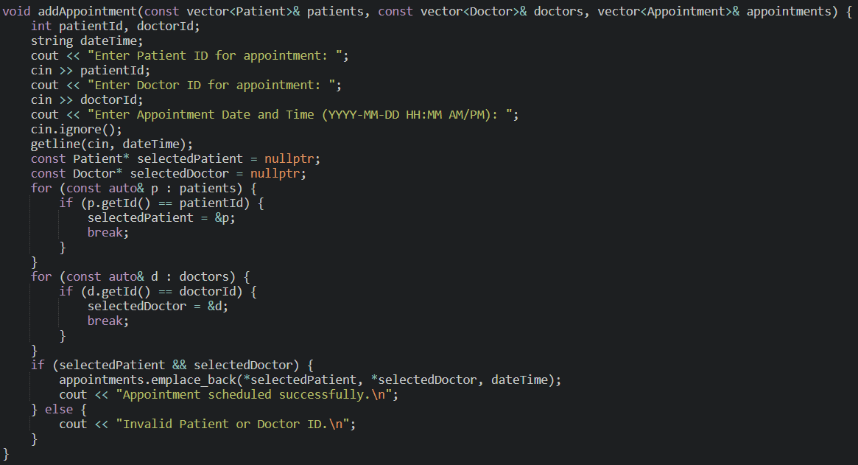
SLIDE - 11
addAppointment Function

Slide 29
SLIDE - 11
addAppointment Function
Purpose: Schedule an appointment by linking a patient with a doctor.
Details: Prompts for patient and doctor IDs, verifying that both exist in the system.
Links the patient and doctor using dateTime, creating an Appointment instance.
Searches for patient and doctor records by ID to confirm validity
Functionality: Facilitates the scheduling of appointments, organizing patient
doctor interactions.
Ensures that only existing patients and doctors are assigned to appointments, reducing errors.

Slide 30
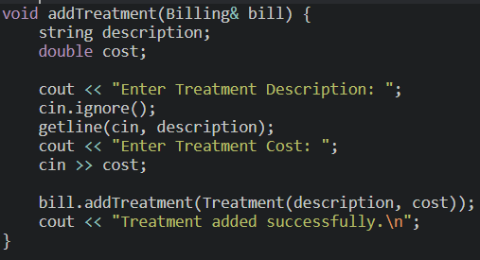
SLIDE - 12
addTreatment Function

Slide 31
SLIDE - 12
addTreatment Function
Purpose: Capture and add a treatment to a patient’s billing.
Details: Collects description and cost of a treatment, which are added to the Billing object.
Functionality: Adds treatments to a patient’s bill, helping track medical costs.
Provides an organized way to manage multiple treatments under one billing system.

Slide 32
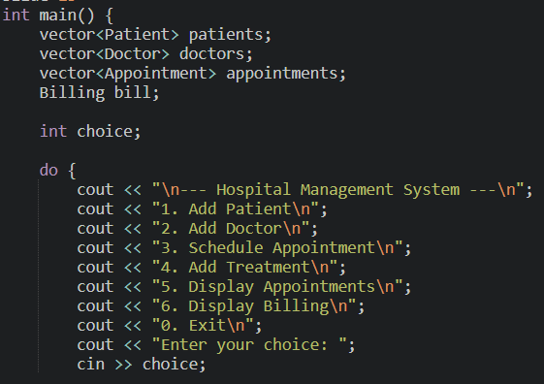
SLIDE - 13
Main Menu

Slide 33
SLIDE - 13
Main Menu
Purpose: Provide a command-line interface (CLI) for user interaction with the HMS.
Details: Displays options for adding patients, doctors, scheduling appointments, and managing billing.
Users can choose actions interactively, with each action tied to a specific function.
Functionality: Serves as the main interaction point, allowing users to navigate and operate the HMS.
Organizes system functionalities in an easy-to-use menu, making the HMS accessible.

Slide 34
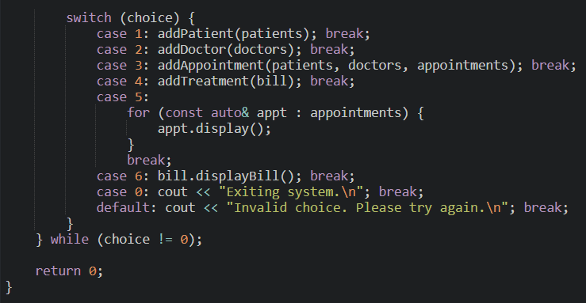
SLIDE - 14
Switch-Case Menu Handling

Slide 35
SLIDE - 14
Switch-Case Menu Handling
Functionality: Routes user selections to relevant functions, ensuring smooth interaction with the system.
Allows continuous operation, giving users flexibility in managing HMS tasks.
Purpose: Control program flow based on user input from the main menu.
Details: Switch-case structure calls appropriate functions based on the selected choice.
Ensures the program continues until the user selects the exit option (0).
Provides error handling for invalid choices.

Slide 36


Key Findings
Object-Oriented Design: Uses classes (Person, Patient, Doctor, etc.) with inheritance and composition for clear structure.
Abstract Base Class: Person is abstract, ensuring only Patient and Doctor can be instantiated.
Modular Interface: Menu-driven interface for easy interaction and extensibility.- Effective
Display: Uses set precision for cost formatting; cleanly summarizes billing.

Slide 37


Example
Mahi is managing a hospital's operations and uses the HMS to:
Add a patient named John Doe with ID 101.
Add a doctor named Dr. Smith with ID 201.
Schedule an appointment for John Doe with Dr. Smith on 2024-11-20 at 10:00 AM.
Add a treatment for John Doe with the description "Blood Test" costing $150.00.
View the list of appointments.
Generate and display the billing summary.

Slide 38


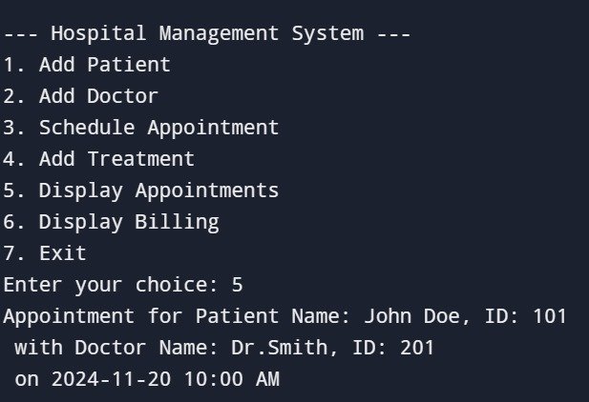
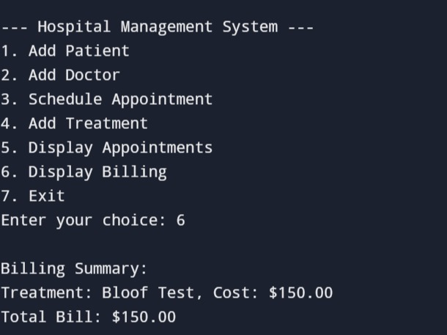


RESULTS

Slide 39



CONCLUSION
The code for this Hospital Management System (HMS) shows how object-oriented programming concepts can be implemented in a reliable and scalable manner. It efficiently models real-world entities like patients, doctors, appointments, treatments, and billing by utilizing ideas like inheritance, abstraction, and encapsulation.
One of its advantages is its modular design, which facilitates expansion and maintenance. Use of object-oriented design is strong, guaranteeing readability and reusability. A simple and easy-to-use CLI for hospital operations management.
In general, the code offers a strong basis for creating a more thorough HMS and can be improved further and modified for use in practical applications.

Slide 40

THANK YOU
Mahendra Kumar - AP23110010328
Surya - AP23110010323
Sumanaswi - AP23110010300
Medha - AP23110010257

